Slide 1
Mini-Stream Information Session 2023 - 2024
Monday, February 6th, 2023

Slide 2
Today’s Agenda:
SKHS Mini-Streams
Eligibility
Mini-Stream Options
Athletic Therapy
Strength & Conditioning
Application Process
KNPE/HLTH 300: Community-based Practicum
Research–based Mini-Stream
Disability & Physical Activity Certificate (DIPA)
Questions

Slide 3
Student Eligibility For Mini-Streams
KIN students
eligible to apply for both mini-streams
Only able to take part in ONE of these mini-streams over the course of student’s undergraduate program
Note: Students may apply for more than one mini-stream however if accepted to more than one, they will have to choose which one they intend to complete.
Note: Students are able to complete the Research Mini-Stream in combination with either of these 2 streams

Slide 4
Eligibility Criteria for Mini-Streams
Academic criteria
2.7 (B-) cumulative GPA in your KIN program
Prerequisite courses (for progress from one level to the next)
Approval of Mini-Stream Coordinator and UG Coordinator
Non-academic criteria
Current First Aid & CPR
Current Police Check (vulnerable populations screen)

Slide 5
Foundation Theory Courses
Athletic Therapy
KNPE 331 Care and Prevention of Athletic Injuries
Strength & Conditioning
KNPE 345 The Science and Methodology of Sport Training Conditioning Programs

Slide 6
Mini-Stream Coordinators
Athletic Therapy:
Ryan Bennett (ryan.bennett@queensu.ca)
Strength & Conditioning:
Colin McAuslan (colin.mcauslan@queensu.ca)

Slide 7
AT Mini-Stream
Level 1
Fall: shadowing current Student Trainers at Varsity games & practices
Winter: KNPE 331
Lab sessions 2 hrs/week in the clinic (ARC)
Shadowing certified staff in clinic

Slide 8
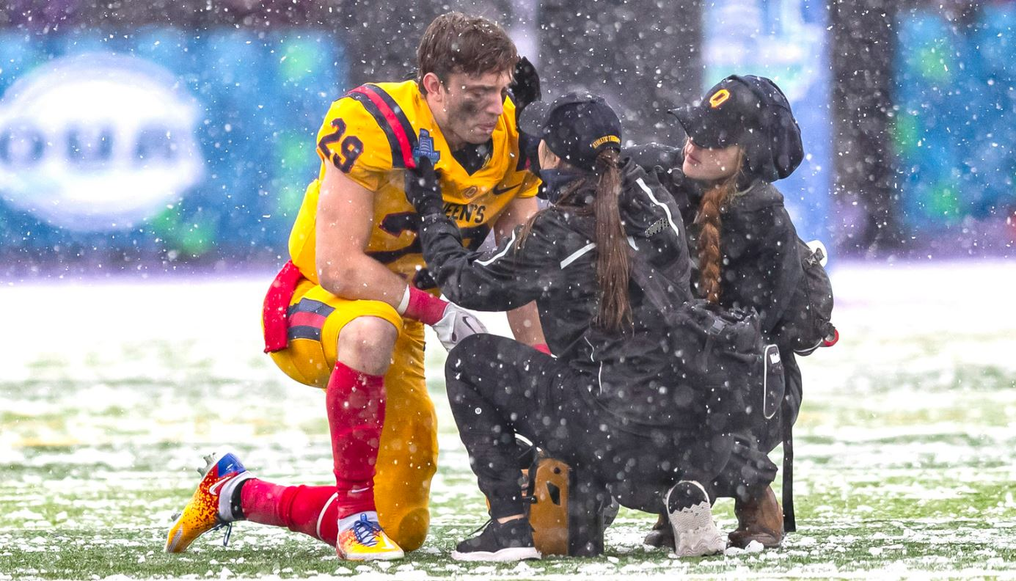
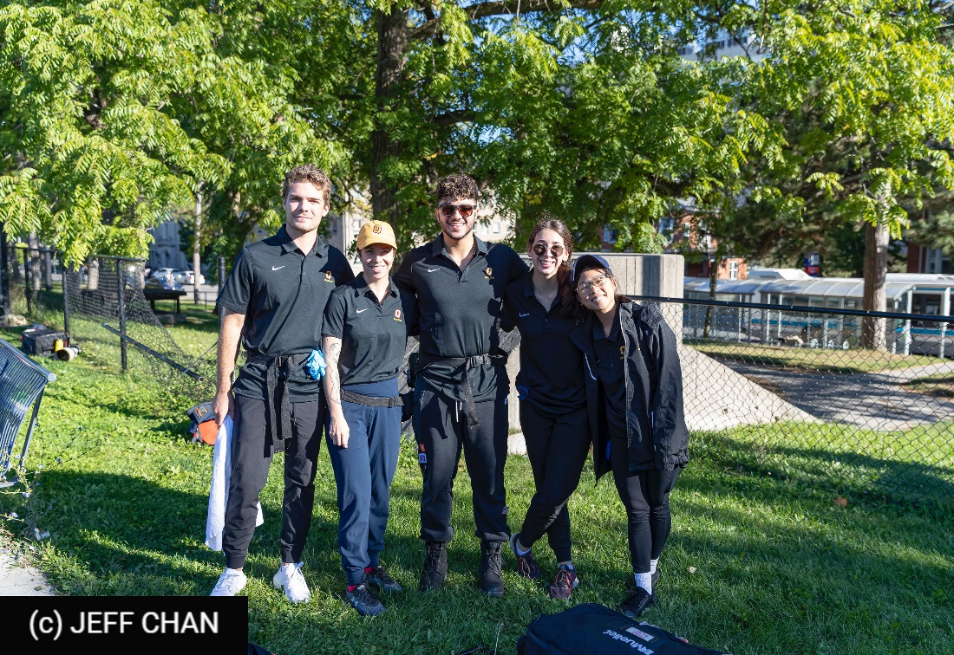
AT Mini-Stream
Level 2: Field Placement (KNPE 330/4.5)
Placed with a Varsity team to cover practices and games
165 field hours
Pre-event taping, wrapping, massage, etc.
During event emergency first-aid
Post-event treatment
Academic: 2 assignments, 1 with presentation, first-aid practical

Slide 9
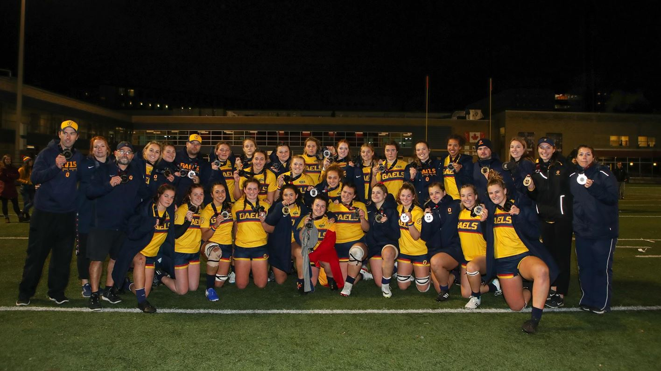
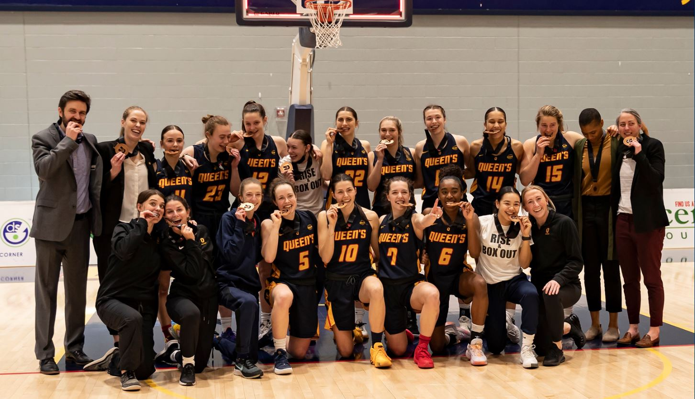
AT Mini-Stream
Level 3: Field & Clinic (KNPE 430/ 4.5)
85 field hours & 80 clinic hours
Students continue placement and coverage of team
Mentor junior Student Trainers
Students expected to shadow in clinic assisting Certified Athletic Therapists
Academic: Literature review with presentation, Clinical practical

Slide 10
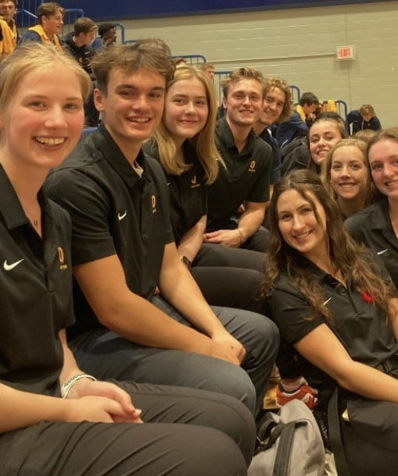
Athletic Therapy Mini-Stream Notes
Please note:
Level 2 & 3 ALWAYS requires students to be available to start in the mid-August to early September (depending on sport).
Level 2 & 3 ALWAYS conflicts with Frosh Week/Safety Officer
Level 2 & 3 MAY conflict with holidays: Thanksgiving, Christmas, reading weeks
Varsity Team athletes not accepted into program
What we expect from you:
Quick learners, keen, willing to go above and beyond, good time management, good communicators, engaged learners, works well as part of a team. Adaptable personality, thinks quickly in stressful situations and dependable.

Slide 11
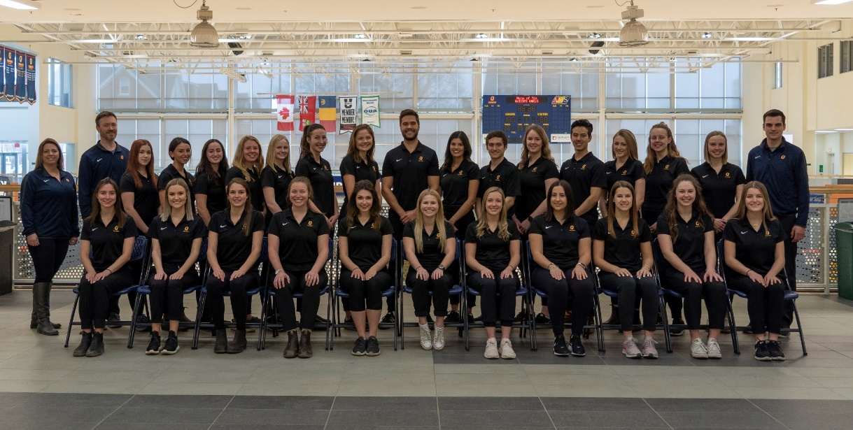
AT Mini-Stream
What you can expect from us
Hands on training applicable to any of the Health Sciences
Improved communication skills
Improved time management skills
Crisis and stress management skills
Life-long friends from the Student Trainers, Coaches and Players you work with
An unforgettable, rewarding experience that will be the highlight of your undergrad years

Slide 12
Team Photo from 2019

Slide 13
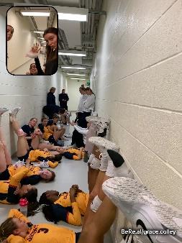
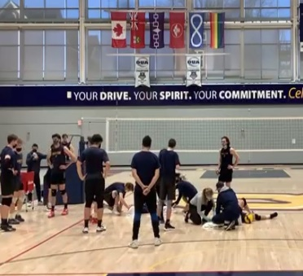
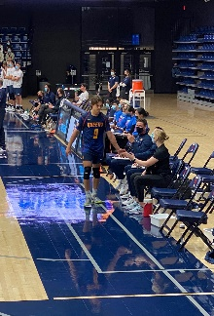
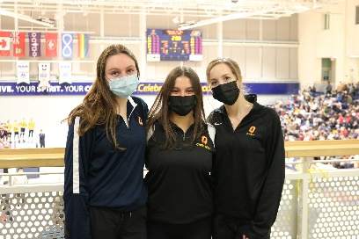
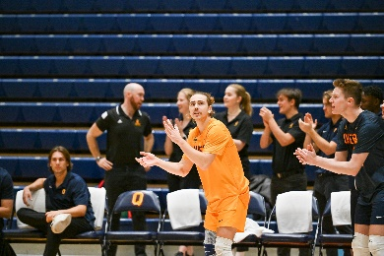
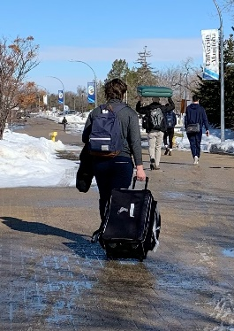
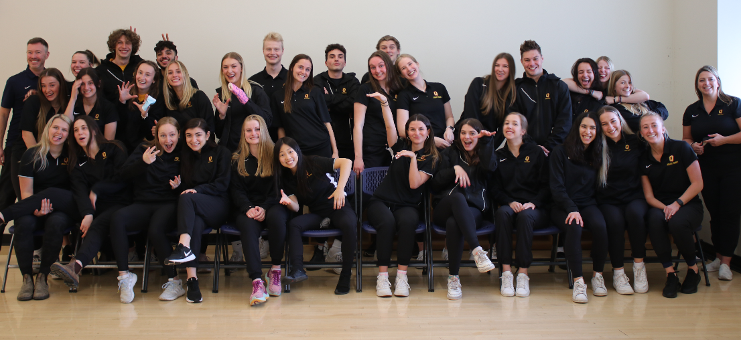
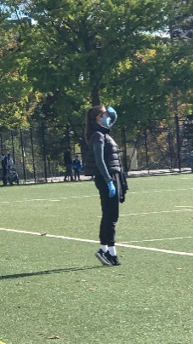
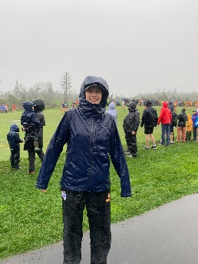
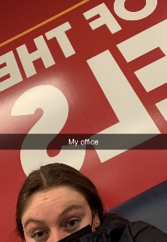
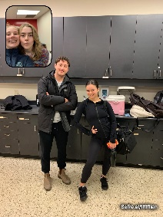
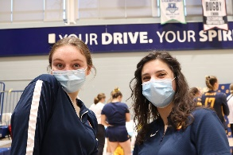
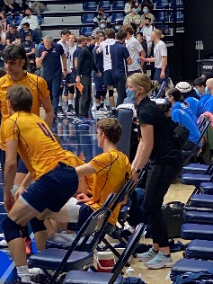
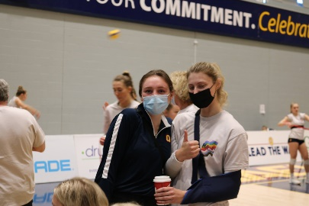
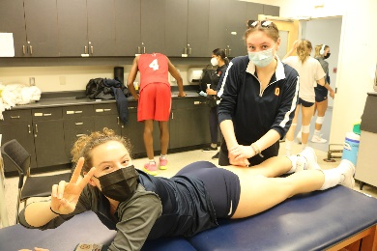
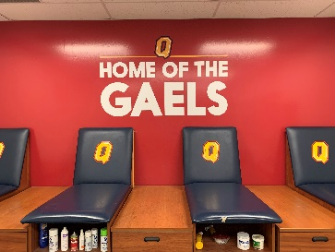
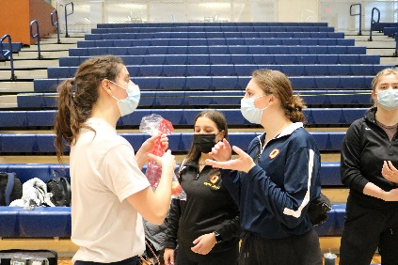
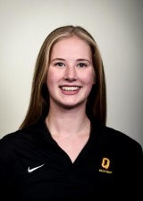
Our Experience- Current STs Alex & Grace
Alex
Grace

Slide 14
Strength and Conditioning Mini-Stream
Level 1
S&C Introductory Internship 24 hrs of shadowing, 24 hours of intern information sessions. Must complete KNPE 345.
Level 2
KNPE 346/4.5 – S&C Field Placement- 120hrs of assisting in coaching at least 2 varsity teams. These interns must attend a weekly meeting, attend coaching seminars and complete a research paper.
Level 3
KNPE 446/4.5 – S&C Internship- 120hrs of varsity coaching and leading one specific team, plus attending a weekly meeting, coaching seminars, and completing a training plan on themselves.

Slide 15
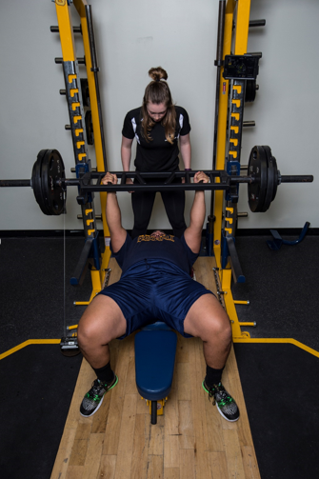
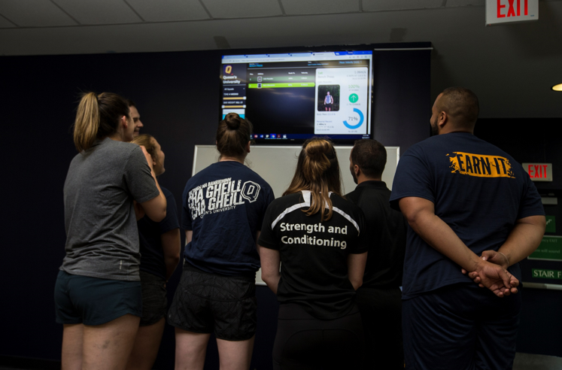
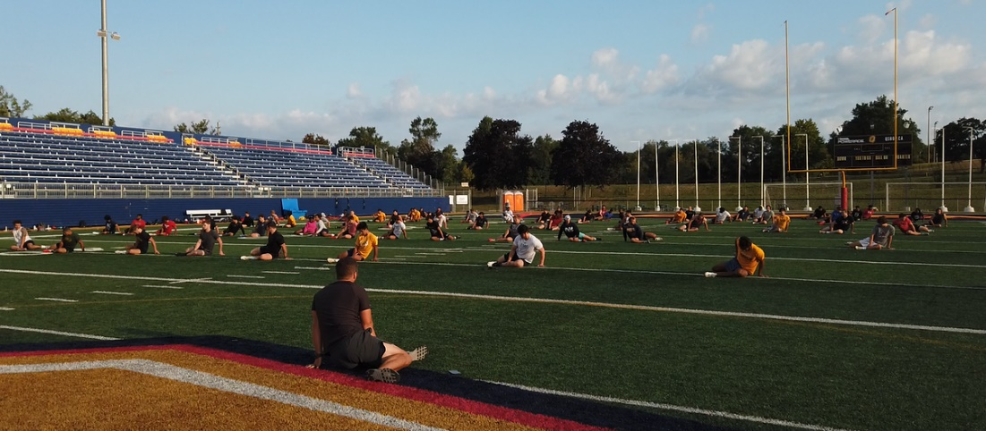
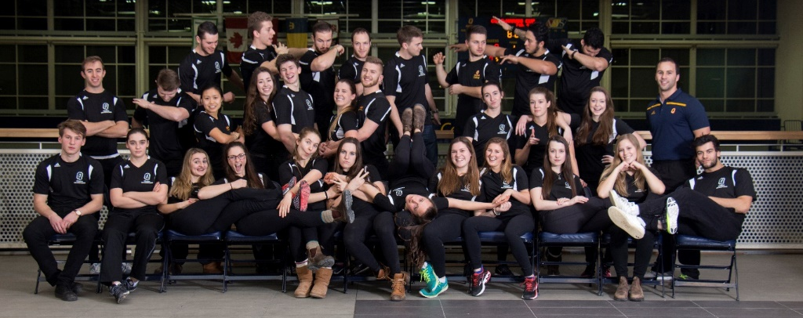
What We Do

Slide 16
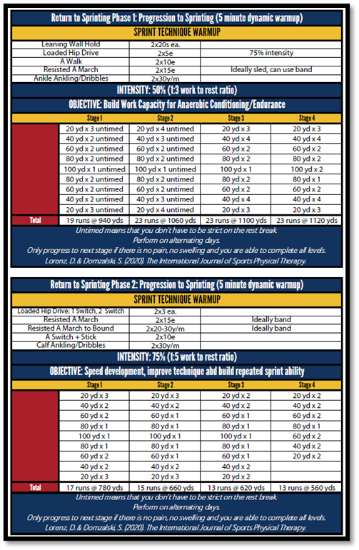
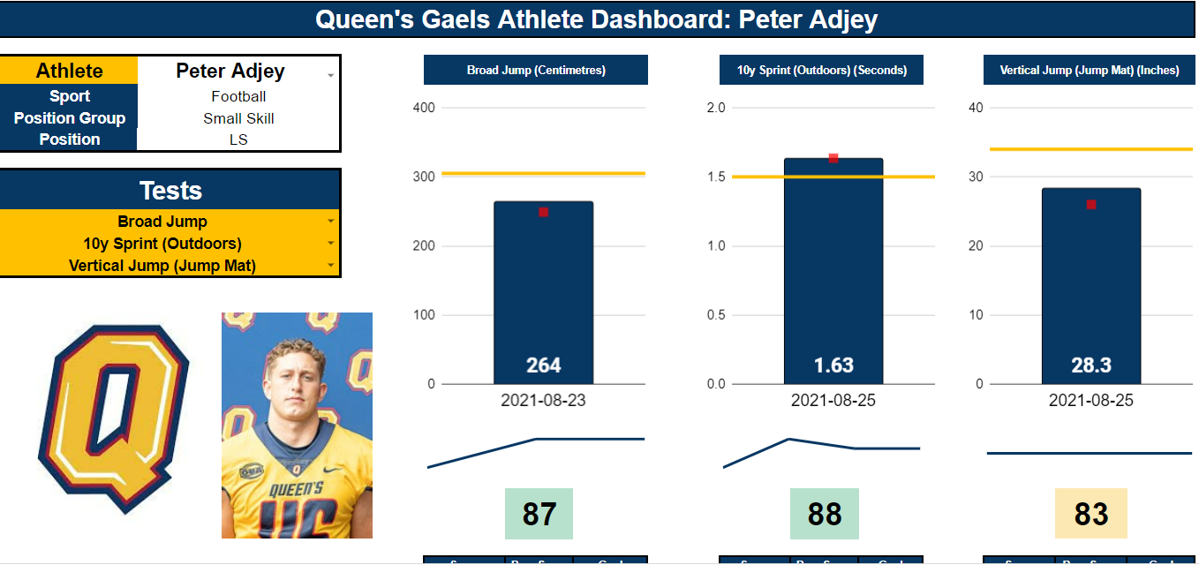
Current Projects

Slide 17
Current Projects

Slide 18
What We Are Looking For
Personable
Stopwatch Mentality
Played Sport
Busy Person
Selfless
Trains Regularly
Morning Person
Willing to Coach
Intern Training Camp: Early Sept

Slide 20
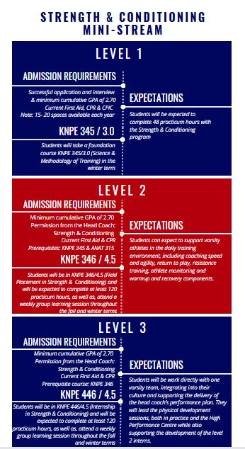

Slide 21
Application Process
Application Deadline: Monday, March 6th @ 11:59pm
Late or incomplete applications will not be accepted
Application Requirements:
Current resume
Cover letter: please outline your relevant past experiences and explain why you are interested in the mini-stream
Instructions:
Applications for all mini-streams must be sent to Michelle Shorey at skhs.internships@queensu.ca.
The email's subject line must contain the name of the mini-stream.

Slide 22
Application Process
Please note:
Students are permitted to complete only one mini-stream, but are allowed to apply to more than one.
Must submit a separate application for each mini-steam.

Slide 23
Application Process
The Coordinator of each mini-stream will read through the applications and select a short-list strong candidates.
Candidates will be asked to attend an interview in March/April
Unsuccessful candidates at this point will not receive an email
Successful students will be accepted with a conditional offer (April/early May)
If selected to more than one, students will be asked to pick at this point
All student who get an interview will receive an email as to whether they have been selected or not to move forward with process

Slide 24
Application Process
SKHS Admin Office conducts final check for academic eligibility in the middle of May.
Students are officially notified (at the end of May) if they have received a spot in the mini-stream (after their GPA has been checked)
Successful applicants will be registered in the appropriate foundation course before Course Registration commences in July.

Slide 25
HLTH/KNPE 300: Community-based Practicum
Course Description:
HLTH/KNPE 300 provides students with an 84-hour community-based placement opportunity related to their field of study, including but not limited to:
fitness facilities, community health centres, not-for-profit organizations and allied healthcare clinics (e.g., physiotherapy, occupational therapy, chiropractic, naturopathy, athletic therapy, etc.)
Through pre-placement workshops, course seminars and their community-based placement, students will gain and utilize a wealth of professional development skills and experience.

Slide 26
HLTH/KNPE 300: Community-based Practicum
Offered annually in the winter term
Contact Hours:
Seminars: 1.5 hour per week x 12 weeks
Practicum: approx. 7 hours per week (84 in total)
Prerequisite:
Level 3 in a KIN or HLTH Major or Medial plan.
Minimum cumulative GPA of 1.90.
Exclusion:
KNPE 330/430, KNPE 346/446

Slide 27
HLTH/KNPE 300: Community-based Practicum
Applications due: Monday, March 6th @ 11:59pm
Application requirements:
Current resume
Statement of intent (including what area you are interested to do your placement in and why).
Inquiries and applications to Michelle Shorey at skhs.internships@queensu.ca

Slide 28
Research Mini-Stream
There is No Enrolment Process for Research Mini-stream
4 Course Components
KNPE 251 Introduction to Statistics
HLTH 252 Introduction to Research Methods
KNPE 352 or HLTH 352 Research Skills Development Practicum*
KNPE 595 or HLTH 595 Honours Thesis*
*application required

Slide 30
Revved Up & Disability and Physical Activity Certificate (DIPA)
Amanda Cunningham, R.Kin, CSEP-CEP, BHK | pronouns: she/her
DIPA & Revved Up Coordinator |School of Kinesiology and Health Studies |Queen's University

Slide 31
Click to see for yourself

Slide 32
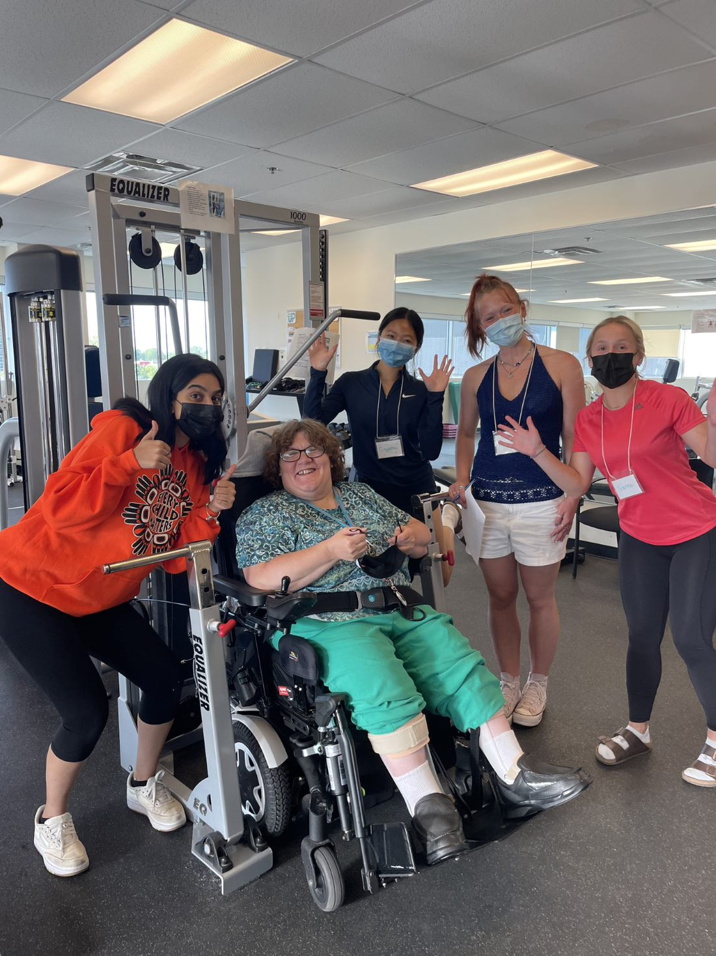
Revved Up Video

Slide 37
Applications are due by May 26th, 2023
Visit the DIPA website for updates and information.
Notes:
If accepted- valid CPIC + First Aid & CPR

Slide 39
Questions?
Athletic Therapy:
Ryan Bennett (ryan.bennett@queensu.ca)
Strength & Conditioning:
Colin McAuslan (colin.mcauslan@queensu.ca)
KNPE/HLTH 300:
Michelle Shorey (skhs.experience@queensu.ca)
Research Mini-Stream:
Rob Watering (watering@queensu.ca)
Disability & Physical Activity Certificate
Amanda Cunningham (dipa.coordinator@queensu.ca)

