Slide 1
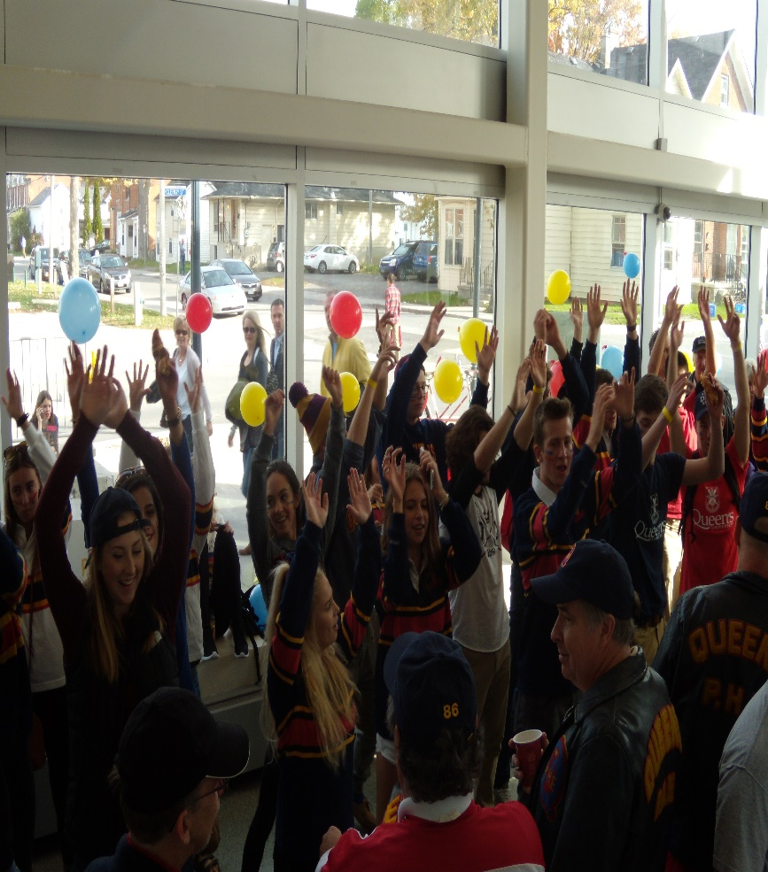
Anna van der Meulen, SKHS Undergraduate Chair
Vanessa McCourt, Academic Advisor
Registration for Health Studies students:
everything you need to know
Notes:
While we are waiting for others to join, type in the chat box why you chose Health Studies!

Slide 2
What does second year
look like?
Health studies
2022-23 Registration Information
Course Selection
Questions?
Notes:
We will discuss these topics in depth throughout the presentation and have time at the end for any questions you may have. You can either keep them until the end or use the chat box and type your question as they come up.

Slide 3
Registration Timelines
Mark the dates in your calendar!
Info is posted on the
SKHS website:
UG Newsletter
Timetable
Important Dates
YR 2 registration – FRI. JULY 22
skhs.queensu.ca/registration-orientation/registration/
Notes:
There are some registration dates that you need to be mindful of. We have listed all the dates at the website listed here. Pay attention to these dates so you don’t miss your registration day!
During appointment times, some courses are reserved for students in certain degree plans, or in certain levels. This helps give access to courses to particular students regardless of when their appointment time is.
A note about Wait lists
They are put on all single term courses. The wait list capacity will be 10% of the overall capacity of the course. During restricted enrollment if the course has a reserve capacity on it and the student does not meet that reserve capacity (but does meet prerequisites), you can opt to join the wait list. As stated above the reserves all expire on July 27 (12:01 am) this year. Once the reserve capacity expires, the students on the wait list will be enrolled into the class, provided there is space in the class.
Take a look at the Draft Timetable on our website that lists the courses that we will be offering in the fall & winter terms as well as the course summaries that break down the learning outcomes & expectations, texts and reading materials you will need, and the course evaluation.

Slide 4
Choosing
second year
classes
Notes:
Since first year was a common year, you can now choose which courses will fit with your chosen major – Health Studies!
Degree requirements vary – it is your responsibility to know your requirements – BAH Major, Joint Honours (formerly medial), Minor
The next slide will show you what courses you will be taking during your second year.

Slide 5
Register yourself into Yr 2 Core Courses
HLTH Major/ Joint Honours:
Fall term | Winter term
HLTH 205/3.0 Introduction to Health Promotion | ANAT 101/3.0 or ANAT 100/3.0 (ANAT 100 is also offered in Fall term) Anatomy of the Human Body
KNPE 251/3.0* Introduction to Statistics | KNPE 125/3.0 Introduction to Human Physiology
HLTH 252/3.0 Introduction to Research Methods | + 9.0 units options/electives or Joint Honours/ Minor requirements
+ 6 units options/electives or Joint Honours/Minor requirements | *please contact us if you would like us to preregister you into HLTH 102 if you didn’t take it in 1st yr (email skhs.ugassist@queensu.ca)
Notes:
KNPE 251 may be substituted for any approved stats course – e.g., STAM 200

Slide 6
Register yourself into Yr 2 Core Courses
HLTH Minor/ General:
Fall term | Winter term
HLTH 205/3.0 Introduction to Health Promotion | ANAT 101/3.0 or ANAT 100/3.0 (ANAT 100 is also offered in Fall term) Anatomy of the Human Body
+ 12.0 units options/electives or Major requirements | + 12.0 units options/electives or Major requirements
 | *please contact us if you would like us to preregister you into HLTH 102 if you didn’t take it in 1st yr (email skhs.ugassist@queensu.ca)
Notes:
KNPE 251 may be substituted for any approved stats course – e.g., STAM 200

Slide 7
Know your plan
Use your Degree Audit Form & Progress Report to track your progress through your degree

Slide 8
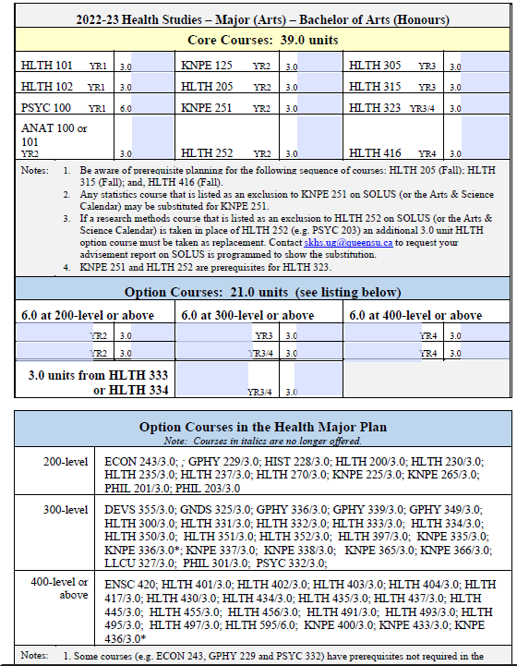
39 units of Core Courses
21 units of HLTH/KNPE Options
Note: you can take Option courses from other departments

Slide 9
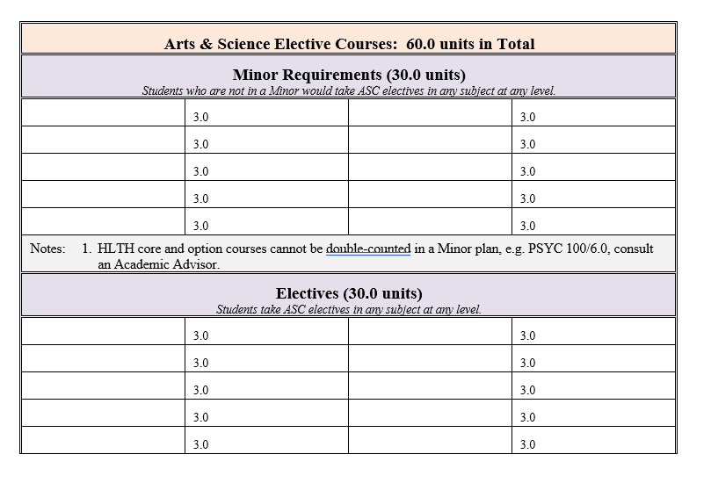
60 units of electives
OR
30 units of Minor Requirements
and 30 units of Arts & Science
electives
Using your
HLTH degree audit form

Slide 10
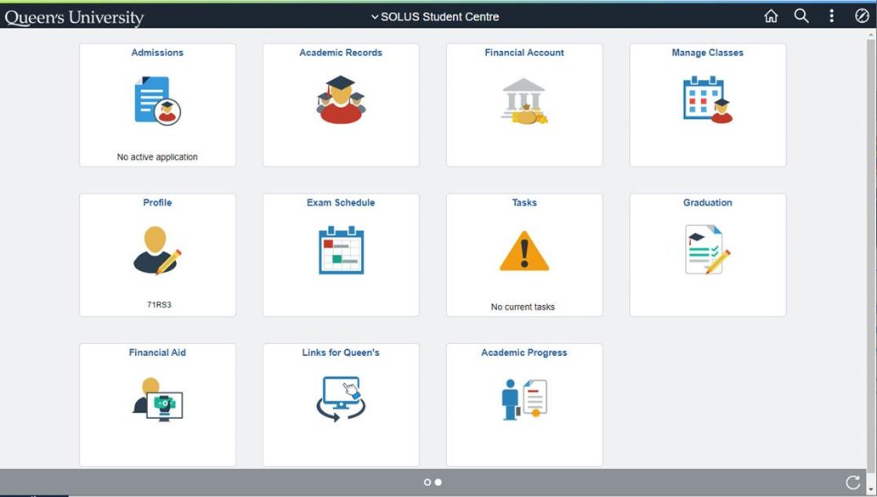
Using your Progress Report to track your progress through your degree

Slide 11
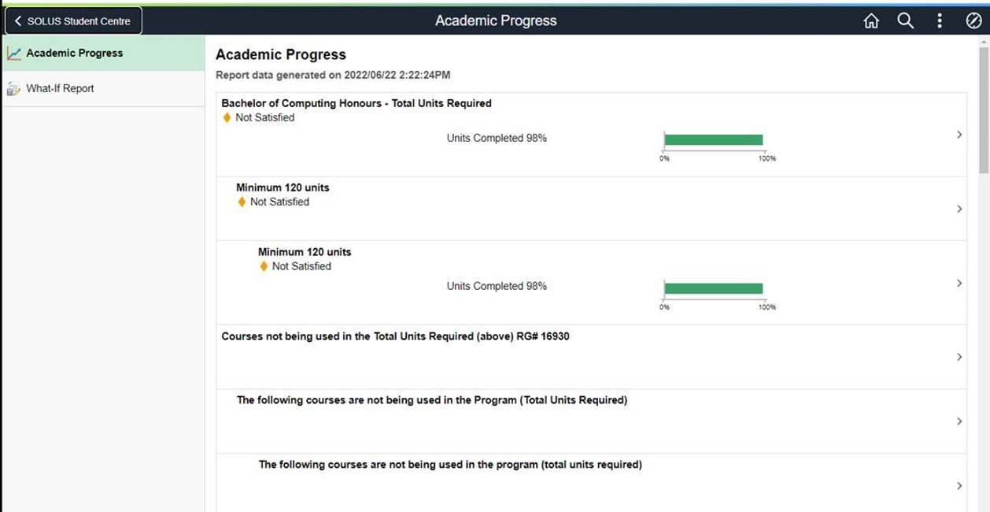
Using your Progress Report to track your progress through your degree

Slide 12
What electives should I choose?
Notes:
Next slide discusses strengths, etc.

Slide 13
Know your strengths
interests
engagement
passion
abilities
strengths
competencies
STRENGTH ZONE
Notes:
Remember you are in your strength zone when you pick courses that both interest you and you have the ability to learn.
It’s when you do your best work!
Think about post graduate opportunities and courses you might need to take in order to apply.

Slide 14
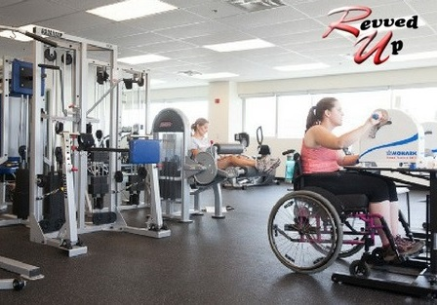
Hands On
Opportunities
DIPA – certificate in Disability & Physical Activity
HLTH 300- Community Based Practicum
KNPE 337 - Physical Activity for Children & Youth (take HLTH 270 as pre-requisite)

Slide 15
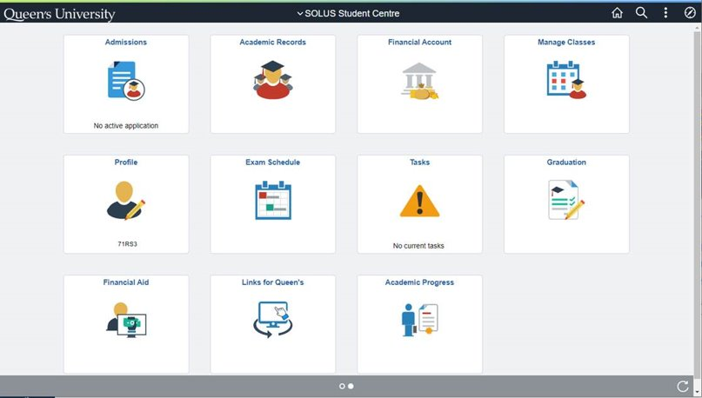
Registering for classes
July 11 you can see your registration appointment time in SOLUS and can add courses to your shopping cart!

Slide 16
Use your queensu.ca email (include your full name, student #, program & year)
Read through Issue 1 of the UG Newsletter (June 24)
Select your electives
Be prepared for your enrollment time – some classes fill early!
Pay attention to emails from SKHS re: registration
Pay any outstanding fees so you can register for courses
Things to
remember
Registration hiatus August 1-14
Notes:
Registration hiatus – August 1-14

Slide 17
Questions? Contact Us! Include name, student number, program & year
Name: | Responsible for:
Trish Stenzl, UG Program Assistant skhs.ugassist@queensu.ca | General registration inquiries Issues with labs/tutorials
Vanessa McCourt, Academic Advisor skhs.ug@queensu.ca | Degree & Plan requirements Pre-requisite issues Program/plan changes International exchange advice
Anna van der Meulen, UG Chair skhs.ugchair@queensu.ca | Transfer credit assessments Appeals for exceptions to program Approval for independent courses/mini-streams
Michelle Shorey, Student Experience Coordinator skhs.experience@queensu.ca | Community-based internships (HLTH/KNPE 300) Mini-streams
Amanda Cunningham, DIPA Coordinator dipa.coordinator@queensu.ca | Certificate in Disability & Physical Activity Revved Up exercise program
Rob Watering, Laboratory & Educational Coordinator watering@queensu.ca | Research-based Practicum (HLTH/KNPE 352)

